Slide 1
The Most Beautiful Melodies Ever Sung
The Story of Opera

Slide 2
The Plan
● The goal of this presentation
● A theory about humanity
● Techniques for listening
● History & vocabulary
● Sample a few great arias

Slide 3
The Goal
To persuade you that opera is:
● Deeply rooted in the essence of being human
● Was created from traditional and enduring forms of ritual,
drama and music dating back at least 30,000 years
● Embraces and expresses timeless human emotions
● An art that belongs to everyone, all cultures, all over the world

Slide 4
A Theory of Humanity
The one and only thing that distinguishes humanity from the rest of the
Animal kingdom is mankind’s invention of and relentless use of
Fiction
Humanity begins with the creation of fiction
Fiction begins with art

Slide 5
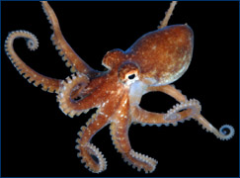
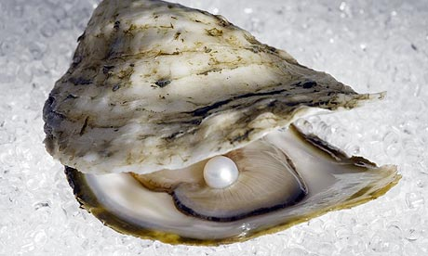
The Range of Listening Practices
The Oyster
Fixated Listening
The Octopus
Grabs every possible
listening experience

Slide 6
Opera
An art form in which singers and musicians perform a dramatic
work combining text (called a libretto) and musical score
● Dance is not part of the operatic form. The Broadway Musical form is
obliged to incorporate dance in its composition
● Plural form of the Latin word opus meaning “work”
● 1644 – first known use in English

Slide 7
The History of Opera
almost
● 1580 - The Camerata of Florence, Italy sought to recreate the ancient Greek tradition of
combining music with dramatic performances.
● A line from Aristotle's work Poetics was the Camerata’s guiding principle:
Tragedy , then, is an imitation of some action that is important, entire and of a proper magnitude – by language rendered pleasurable . . . language that has the embellishments of rhythm, melody
and meter . . . In some parts meter alone is employed, in others, melody.
● The Camerata sought to rebel against the complex polyphony of the Renaissance. The musical
theorist of the Camerata was Vincenzo Galilei. He argued for monody – single line music.
● Dafne, written by Jacopo Peri in 1594 is acknowledged to be the world’s first opera.
● The first masterwork of opera is L’Orfeo written by Claudio Monteverdi, first performed in 1607

Slide 8
History of Opera The Parallel Story
● The Protestant Reformation caused church leaders to seek music that
would more effectively convey the teachings of the church to a largely
illiterate population.
● Just like the Camerata, church leaders rebelled against the complexity
of Renaissance polyphony.
● Simultaneously the secular world developed opera and
the religious world developed the oratorio

Slide 9
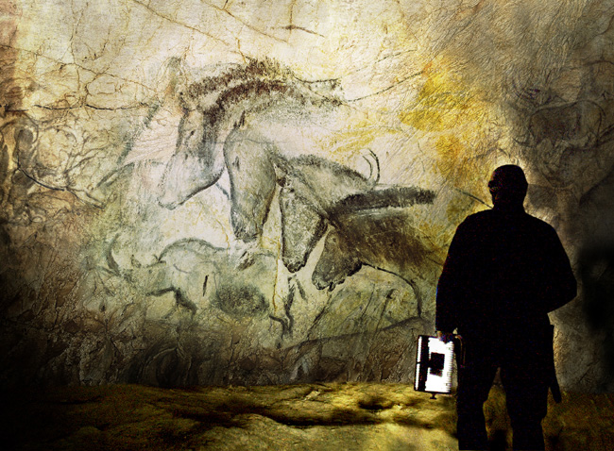

Slide 10
The Bardic Tradition
Diodorus Siculus (Greek Historian)
Bibliotheca Historica
Between 60 and 30 BCE
And there are among them composers of verses whom they call Bards;
these singing to instruments similar to a lyre, applaud some, while they
vituperate others.
● Bards are -
Keepers of memories
Commentators on modernity
Sentinels who warn about the future
Custodians of history and the sacredness of the world
● About 1600 CE the ancient bardic tradition fused, with the ancient
tradition of drama and the newly formed discipline of orchestrated music
to establish the art form known as opera.

Slide 11
Coloratura
The word derives from the Latin word colorare - meaning "to color”.
“Coloratura” is simply elaborate vocal music
used to describe the style of operatic singing common during the
18th and 19th centuries:
Recognized by vocal athleticism: runs, trills, wide leaps, or other
such virtuoso- technique
The instrumental equivalent is called ornamentation.

Slide 12
The Coloratura of Opera A Traditional Style
Sean Nos –from Ireland
Listen to a Performance of Sean Nos
In Gaelic – in a Pub
In English

Slide 13
Folk Ballad Styles of the Middle East
Listen to a Traditional Performance of Singing,
Oud and Percussion at this link

Slide 14
Formal Performance of Medieval Turkish Literature
View a bardic performance of the Turkish medieval classic
The Epic of Koroghlu
This clip was extracted from Michael Wood’s documentary titled In Search of the Trojan War.
The six DVD series is available for purchase or to view on YouTube. The segment above
was taken from episode #3 of the documentary
In Search of The Trojan War on YouiTube

Slide 15
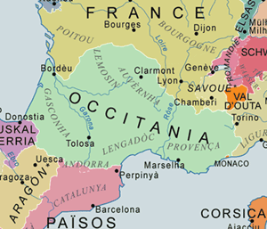
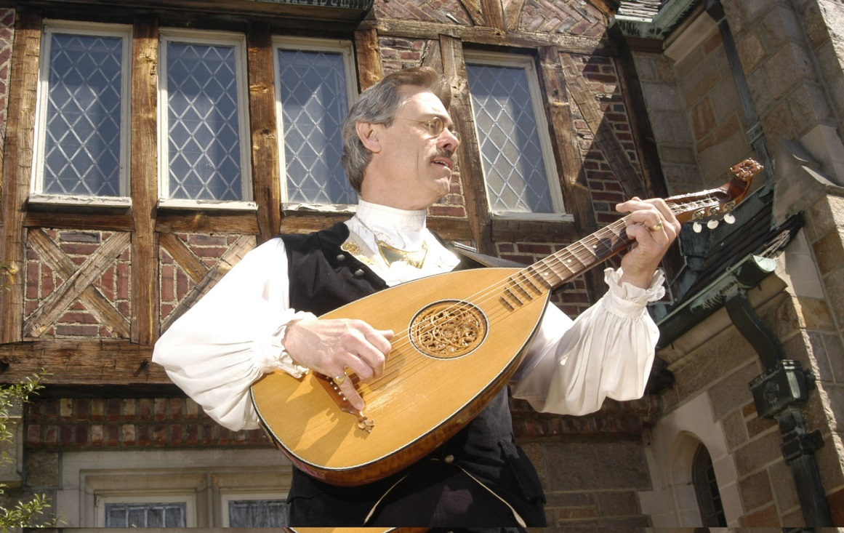
Troubadours - Trobairitz – Trouveres Minnesingers - Jongleurs
● Troubadours, Trobairitz, Trouvères , Minnesigners: 1100-1350
aristocrats who made music.
● Minstrels – itinerant musicians performing in streets and at festivals.
Pre-date troubadours. Popular through the late Renaissance.
● Jongleurs assisted troubadours and minstrels by dancing, conjuring,
performing acrobatics, juggling, storytelling.
● Troubadours and minstrels were partly a reaction to the oppressive character of the Medieval Church
Hear a performance of a troubadour love song
Notes:
Occitania, is a cultural region in southern Europe where Occitan was
the principle language.
About a half million people out of 16 million in the area
Speak Occitan proficiently. The Occitan language
has been an official language of Catalonia, Since 2006

Slide 16
Vocal Ranges
Female
Soprano C4–C6
Mezzo-Soprano A3–A5
Alto G3-G5
Overlaping ranges
Contralto – female F3–F5
Countertenor – male – similar to Contralto or Alto
Male
Tenor - C3 – C5
Baritone - G2 – G4
Bass - E2 -E4

Slide 17
Vocal Ranges In Opera
The highest note sung is F6
The Queen of the Night’s Aria
Mozart's opera The Magic Flute.
The lowest note sung is D2
Osmin's second aria
Mozart's opera The Abduction from the Seraglio.
Julie Andres and Michael Jackson both had vocal ranges of four octaves
The greatest vocal range reported is 10 octaves.
The Guinness World Record - Tim Storms holds the record

Slide 18
Most Played Composers
2,415 different works from 1,161 different composers were played.
During the five seasons 2008 to 2012
The most popular composers were:
Giuseppe Verdi - 2,586 performances
Giacomo Puccini - 1,893 performances
Wolfgang Amadeus Mozart - 2012 performances
Richard Wagner - 1,131 performances
Gioachino Rossini – 960 performances
More than 600 of the composers played during this period were alive

Slide 19
Most Popular Operas Five Seasons 2009 – 2014 900 Theatres
La traviata (1853, Verdi) 659 performances
Carmen (1875, Bizet) 548 performances
La bohème (1896, Puccini) 522 performances
Die Zauberflöte (1791, Mozart) 474 performances
Tosca (1900, Puccini) 479 performances
Madama Butterfly (1903, Puccini) 462 performances
Il Barbiere di Siviglia (1816,Rossini) 453 performances
Rigoletto (1851, Verdi) 445 performances
Le Noze di Figaro (1786, Mozart) 420 performances
Don Giovanni (1787, Mozart) 391 performances

Slide 20
Most Popular 20th Century Operas
The Turn of the Screw
Benjamin Britten - 1954
Lady Macbeth of the Mtsensk District
Dmitri Shostakovich -1934
The most popular works by composers alive on 31 July 2012
The Diary of Anne Frank
Grigory Frid -1968
Dead Man Walking
Jake Heggie - 2000

Slide 21
Cities with the Most Opera Performances
During the 2009 – 2014 Seasons
City # of Performances
Berlin 581
Vienna 556
Moscow 539
London 511
St. Petersburg 501

Slide 22
Countries with the Most Opera Performances
During the 2009 – 2014 Seasons
City # of Performances
Germany 7,565
Russia 1,920
USA 1,811
Italy 1,268
France 1,266

Slide 23
Vocabulary
● Bel Canto – “beautiful song” …… vocal style that prevailed throughout
the 18th century and early 19th centuries. meaning is subject to
a wide variety of interpretations. Think “expressive”.
● Coloratura - vocal athleticism common in the 18th and 19th centuries
● Opera Buffa – comic opera
● Opera Seria – “serious” style opera 1710- 1770
● Recitative - a style of delivery in which a singer employs the
rhythms of ordinary speech.
● Singspiel – “sing play”
● Tessitura - the most musically pleasing and comfortable
range for a given singer

Slide 24
Five Qualities of Good Melodies
Small vocal range - generally no more than an octave and a half
Repeating elements are always present
Melodies move by scale steps with occasional leaps.
Melodic leaps are a means to generate spikes of energy.
4. A discernible relationship with the bass line is present.
5. Melodies usually have a climactic point.
Following the climax the melody moves to a resting place often called
a “cadence”. The climax may be the highest pitch of the melody but not
always. The climax is marked by high pitch, meaningful harmony,
strong rhythmic position

Slide 25
The Operas
Rigoletto
Giuseppe Verdi - 1851
La donna è mobile
Pagliacci
Ruggero Leoncavallo - 1892
Vesti la Guibba
Xerxes
George Fredrick Handel – 1738
Ombra mai fu
La Boheme
Giacomo Puccini – 1896
Quando m’en vo’
The Magic Flute
Wolfgang Amadeus Mozart - 1791
Queen of the Night’s Aria
Tosca
Giacomo Puccini - 1900
E lucevan le stelle
The Barber of Seville, or The Futile Precaution
Gioachino Rossini - 1816
Largo al factotum
Madama Butterfly
Giacomo Puccini -1904
Un bel di
Norma
Vincenzo Salvatore Carmelo Francesco Bellini 1831
Casta Diva
Gianni Schicchi
Giacomo Puccini 1918
O mio babbino caro

Slide 26
Rigoletto Giuseppe Verdi - 1851
The opera's original title, La maledizione (The Curse), refers to the curse placed on both
the Duke and Rigoletto by a courtier whose daughter had been seduced by the Duke
with Rigoletto's encouragement. The curse comes to fruition when Rigoletto’s daughter,
Gilda, falls in love with the Duke and eventually sacrifices her life to save him from the
assassins hired by her father.
At the beginning of Act 3, while Rigoletto and Gilda listen outside of a house,
the Duke sings La donna è mobile (Woman is fickle).
Musicologist consider Rigoletto “revolutionary” It changed opera forever.
“I conceived Rigoletto almost without arias, without finales
but only an unending string of duets.”

Slide 27
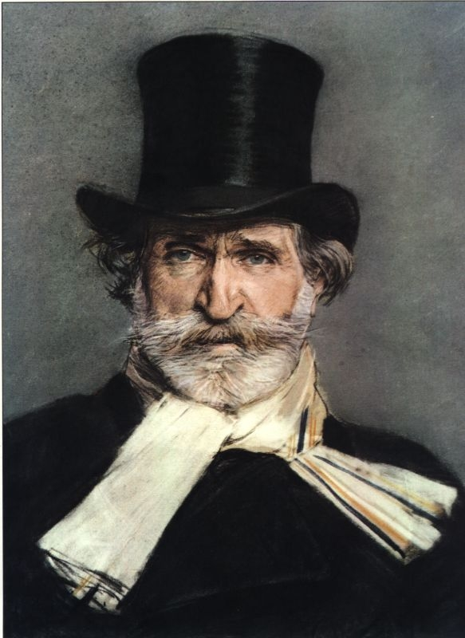
La donna è mobile Woman is unstable
Woman is unstable
like the feather in the wind
she changes tone
and thought.
Always a loveable
cute face
in tears or smiling
it says lies
Woman is unstable
like feather in the wind
she changes tone
and thought,
and thought,
and thought!
He’s always miserable
the one who trusts her
that he confides to her
his unwary heart!
In order not ever feel
completely happy,
Who in this breast
doesn’t taste love
Woman is unstable
like feather in the wind
she changes tone
and thought,
and thought,
and thought!
View La Donna e Mobile in Rehersal
Translation by Luciano Pavarotti view performance here

Slide 28
Xerxes George Fredrick Handel 1738
● The opera is set in Persia in 480 BCE
● Loosely based upon Xerxes I of Persia
● King Xerxes sings Ombra mai fu as the opening aria.
● The song expresses the King’s admiration of his beloved plane tree
● The instrumentation is: first and second violins, viola, and basses.
● Key signature is F major
● Time signature is 3/4 time
● Vocal range covers C4 to F5 with a tessitura from F4 to F5

Slide 29
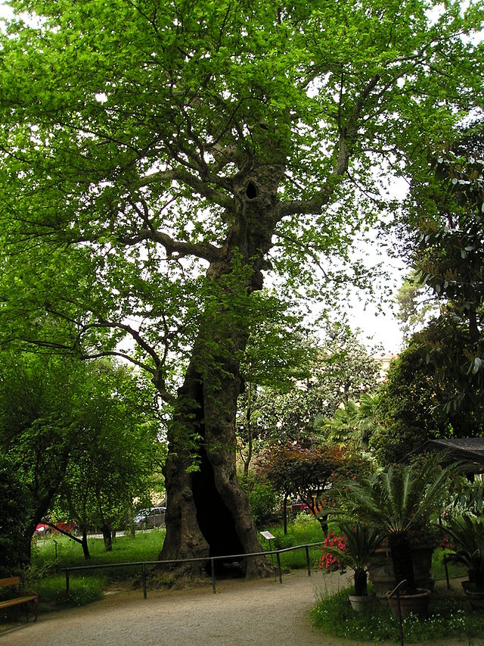
Ombra Mai Fu Never was a Shade
Tender and beautiful fronds
of my beloved plane tree,
let Fate smile upon you.
May thunder, lightning, and storms
never disturb your dear peace,
nor may you by blowing winds be profaned.
Never was a shade
of any plant
dearer and more lovely,
or more sweet.
Andreas Scholl performs Ombra mai fu

Slide 30
Die Zauberflöte The Magic Flute Wolfgang Amadeus Mozart 1791
The last opera written by Mozart –
He conducted at the premier on September 30, 1791
He died on December 5, 1791
A compound work of both opera seria and opera buffa
A lose broadside against the Hapsburg Empire and Catholic Church
The plot is pure fantasy – roughly about the love of Prince Tamino
for Pamina – daughter of the Queen of the Night
Following much deception and travail, Pamina and Tamino are united.
The Queen of the Night’s true character is exposed. She is struck by
lightening and is sent to hell

Slide 31
Der Hölle Rache kocht in meinem Herzen The Rage of Hell Boils in my Heart
The rage of Hell boils in my heart,
Death and despair flame about me!
If Sarastro does not through you feel
The pain of death,
Then you will be my daughter nevermore.
Disowned may you be forever,
Abandoned may you be forever,
Destroyed be forever
All the bonds of nature,
If not through you
Sarastro becomes pale as death!
Hear, Gods of Revenge,
Hear a mother's oath!

Slide 32
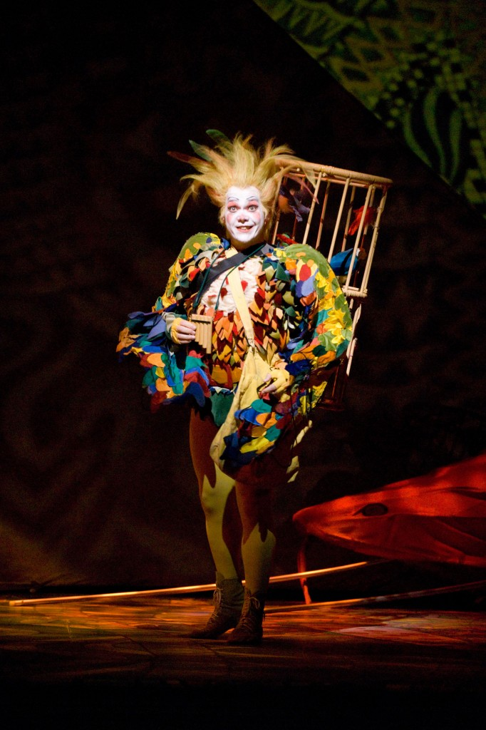
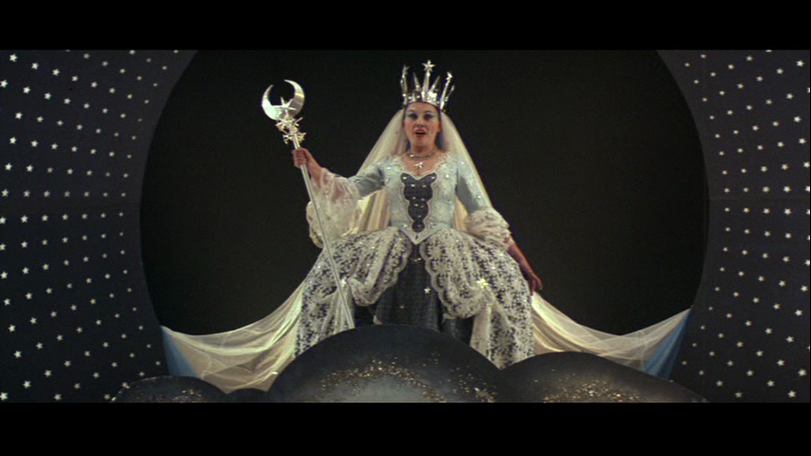
Die Zauberflöte
View Diana Damrau’s Performance of Der Hölle Rache
View the recording of this aria

Slide 33
The Barber of Seville, or The Futile Precaution Gioachino Rossini - 1816 Largo al factotum
● Bartolo, MD is guardian to Rosina. He wants to marry her because
she has inherited a fortune
● Count Almavia falls in love with Rosina but can't get past Bartolo.
● The count disguies himself as Lindoro, a poor music student of Basilio
who is Bartolos' right hand man.
● The count and Rosina make plans to escape and marry
● Bartolo tells Rosina that Lindoro tired to sell her to the count.
● Bartolo arranges for a notary to come that night to marry Rosina and himself
● The count sneaks in by the balcony and tells Rosina of his disguise
● The notary marries the count and Rosina
● The wealthy count tells Bartolo to keep Rosina's inheritance.
● Everyone lives happily every after.

Slide 34
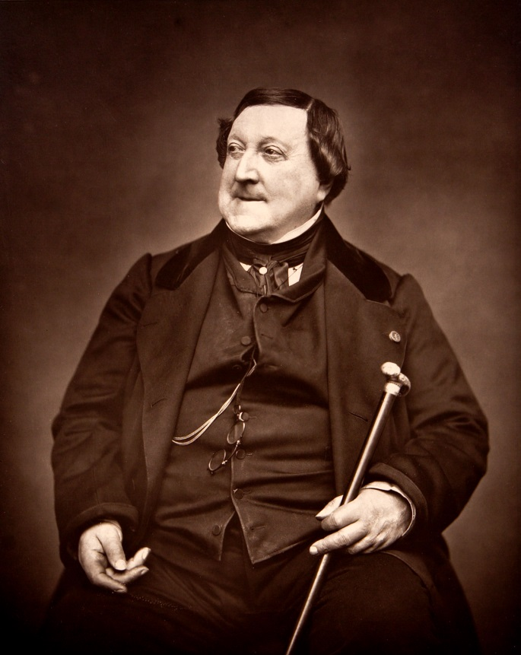
Largo Factotum
Make way for the factotum of the city,
Hurrying to his shop since dawn is already here.
Ah, what a fine life, what fine pleasure
For a barber of quality!
Ah, bravo Figaro!
Bravo, bravissimo!
A most fortunate man indeed!
Ready to do everything
Night and day,
Always on the move.
A cushier fate for a barber,
A more noble life, is not to be had.
Razors and combs,
Lancets and scissors,
At my command
Everything's there.
Here are the tools
Of my trade
With the ladies...with the gentlemen..
Everyone asks for me, everyone wants me,
Ladies, young lads, old men, young girls:
Here is the wig... The beard is ready...
Here are the leeches...
The note is ready...
Here is the wig, the beard is ready,
The note is ready, hey!
Figaro! Figaro! Figaro!, etc.
Ah, what frenzy!
Ah, what a crowd!
One at a time, for pity's sake!
Hey, Figaro! I'm here.
Figaro here, Figaro there,
Figaro up, Figaro down,
Swifter and swifter, I'm like a thunderbolt:
I'm the factotum of the city.
Ah, bravo Figaro! Bravo, bravissimo,
You'll never lack for luck!
View a contemporary performance here

Slide 35
Norma Vincenzo Salvatore Carmelo Francesco Bellini 1831 Casta Diva
● The action takes place in Gaul during the Roman occupation, about 50 BC.
● Norma is the high priestess of the druids who are fighting the Romans
Norma, who is supposed to be a vrigin priestess, has secretly borne Roman
Pro-Counsel Pollione, two sons. Pollione is now in love with a temple virgin,
Adalgisa.
● Adalgisa confess to Norma that she is tormented by a love which is stronger
than her vows. Remembering her own experience, Norma releases Adalgisa
from her vows and asks the name of her lover. Norma threatens Pollione with
vengeance.
● Norma confesses to the druids that she has two sons by Roman Procounsel
Pollione. The two ascend the funeral pyre together

Slide 36
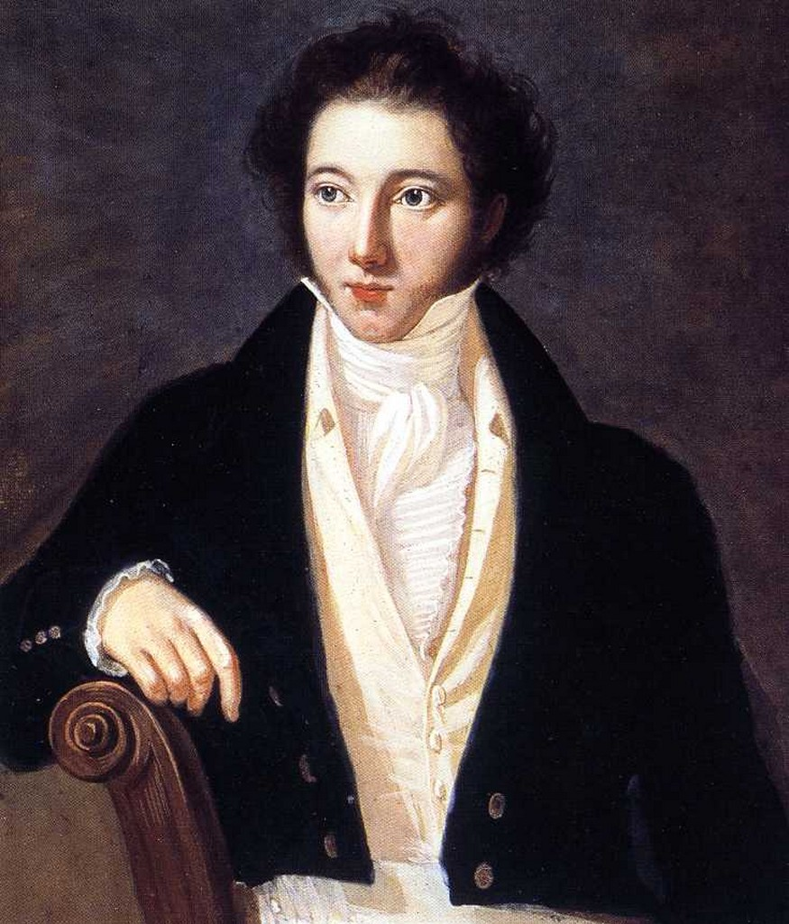
Casta Diva
Virtuous Goddess, covering with silver
these sacred ancient plants,
turn towards us your fair face
cloudless and unveiled
Temper, oh Goddess,
you temper the ardent hearts
furthermore temper the audacious zeal,
spread on earth the same peace
that make you make reign in heaven
Complete the rite
and the sacred forest
should be cleansed of the profane
when the Spirit irate and gloomy,
will ask for the blood of the Romans.
From the Druidic temple
my voice will thunder.
He'll fall; I can punish him.
But my heart doesn't know to punish.
Ah! Come back to me beautiful
to your loyal first love;
and against the whole world
I shall protect you.
Ah! Come back to me beautiful
along with your serene radiance
and life in your womb,
and I'll have homeland and sky.
Ah, come back again as you were then,
then when I gave you my heart,
Ah, come back to me.
View a contemporary performance here

Slide 37
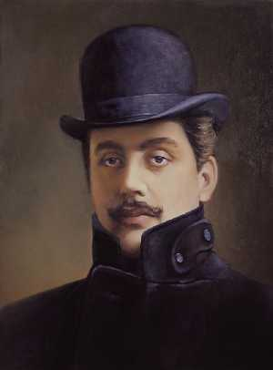
Tosca Giacomo Puccini - 1900 E lucevan le stelle
The stars seemed to shimmer
The sweet scents of the garden,
The creaking gate seemed to whisper,
And a footstep skimmed over the sand.
Then she came in, so fragrant,
And fell into my arms!
Oh! sweet kisses, oh, languorous caresses,
While I, trembling, was searching
For her features, concealed by her mantle.
My dream of love faded away, for good!
Everything's gone now.
I'm dying hopeless, desperate!
And never before have I loved life like this!
And never before have I loved life like this!
View a performance here

Slide 38
I Pagliacci Ruggero Leoncavallo - 1892 Vesti la Guibba
● Canio's wife Nedda has a lover - Silvio
Tonio, a hunchback clown, declares his love of Nedda. She whips him.
He slinks off, vowing vengeance.
● Tanio brings Canio to see Nedda’s assignation
Nedda tells Silvio that she will leave Canio
Canio dresses and makes-up for the performance, reminding himself bitterly
that he is not a man, but only a clown. Vesta la guiba!
● The protagonists of the play act out a drama that mirrors their real life tragedy.
Nedda is forced to confront the reality of her infidelity but refuses to name her
lover Canio stabs Nedda.
Silvio rushes from the audience to save Nedda and is also killed by Canio
Canio pulls the curtain closed and says to theaudience: "The play is over."

Slide 39
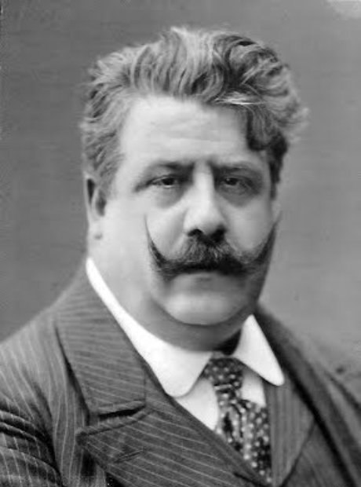
Vesta La Giubba Ruggero Leoncavallo
Recite! While in delirium,
I no longer know what I say,
and what I do!
And yet it's necessary... make an effort!
Bah! Are you a man?
You are a clown!
Put on your costume and powder your face.
The people pay, and they want to laugh.
And if Harlequin shall steal your Columbina,
laugh, clown, and all will applaud!
Turn your distress and tears into jest,
your pain and sobbing into a funny face – Ah!
Laugh, clown,
at your broken love!
Laugh at the grief that poisons your heart!
View a performance here

Slide 40
Madama Butterfly Giacomo Puccini -1904 Un bel di
● Lieutenant Benjamin Franklin Pinkerton of the US Navy marries Cio-Cio-San in Nagasaki
● Pinkerton leaves for a new duty station
● Cio-Cio-San bears Pinkerton’s son
● Pinkerton believes he is free to take up with girls from any port, but will eventually
marry a proper, American wife.
● 3 years later Pinkerkton returns to Nagasaki with his American wife, Kate
● Kate agrees to take the baby boy
● Cio-Cio-San commits suicide and dies at the feet of Pinkerton

Slide 41
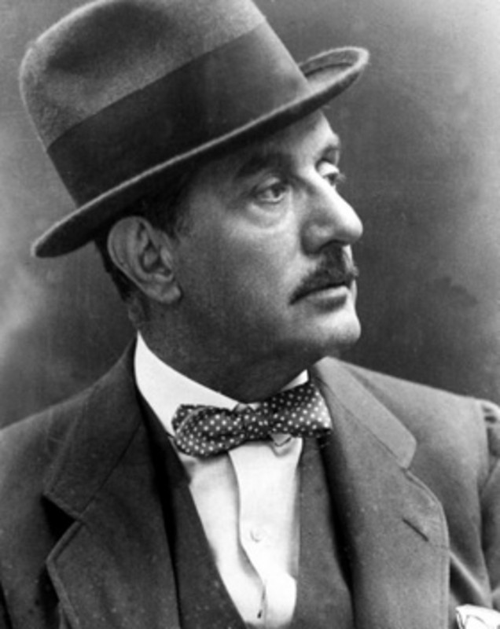
One Good Day
One good day, we will see
Arising a strand of smoke
Over the far horizon on the sea
And then the ship appears
And then the ship is white
It enters into the port, it rumbles its salute.
Do you see it? He is coming!
I don't go down to meet him, not I.
I stay upon the edge of the hill
And I wait a long time
but I do not grow weary of the long wait.
And leaving from the crowded city,
A man, a little speck
Climbing the hill.
Who is it? Who is it?
And as he arrives
What will he say? What will he say?
He will call Butterfly from the distance
I without answering
Stay hidden
A little to tease him,
A little as to not die.
At the first meeting,
And then a little troubled
He will call, he will call
"Little one, dear wife
Blossom of orange"
The names he called me at his last coming.
All this will happen,
I promise you this
Hold back your fears -
I with secure faith wait for him.
View a performance here

Slide 42
La Bohème The Bohemians Giuseppe Verdi 1896
Act 1: Christmas eve 1830 in Paris
The impoverished artists and bohemians are introduced.
Rodolfo and Mimi fall in love.
Act 2: The bohemians go to a café
Musetta attempts to attract the attention of her former lover, Marcello,
to make him jealous of her relationship with the wealthy
(and old) government administrator, Alcindoro. As she grows tired of her
current lover, she sings the song Quando me'n vo’.
Act 4: After much love-anguish in acts 2 and 3, back In the bohemian’s,
garret Mimi dies of TB in Rodolo’s arms

Slide 43
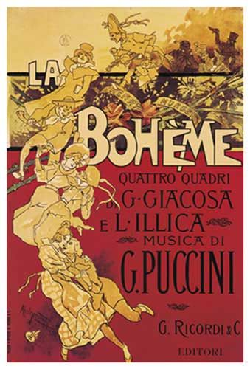
La Boheme Quando m'en vo’
When walking alone on the streets,
People stop and stare
And examine my beauty
From head to toe...
And then I savor the cravings
which from their eyes transpires
And from the obvious charms they perceive
The hidden beauties.
So the scent of desire is all around me,
It makes me happy!
And you who know, who remembers and yearns,
You shrink from me?
I know why this is:
You do not want to tell me of your anguish,
But you feel like dying!
View a performance here

Slide 44
Gianni Schicchi Giacomo Puccini 1918 O mio babbino caro
The wealthy Florentine Buoso Donati has just died. Rumor is that he left all his money to the
monks. The will cannot be found
Rinuccio, finds the will but refuses to hand it over unless his Aunt Zita promises to let him marry
Lauretta, daughter of Gianni Schicchi.
No one outside the family knows that Buoso is dead. Schicchi disguises himself as Buoso,
summons a lawyer and creates a new will.
Schicchi’s false will leaves each relative the bequest they had hoped for. Execept Schicchi gives,
himself the prize items of the house, a mule and the mill at Signa.
He chases the family away, except for Rinuccio, who remains with Lauretta.
Schicchi addresses the audience, begging its indulgence for his sins since it has produced such
a happy result.

Slide 45
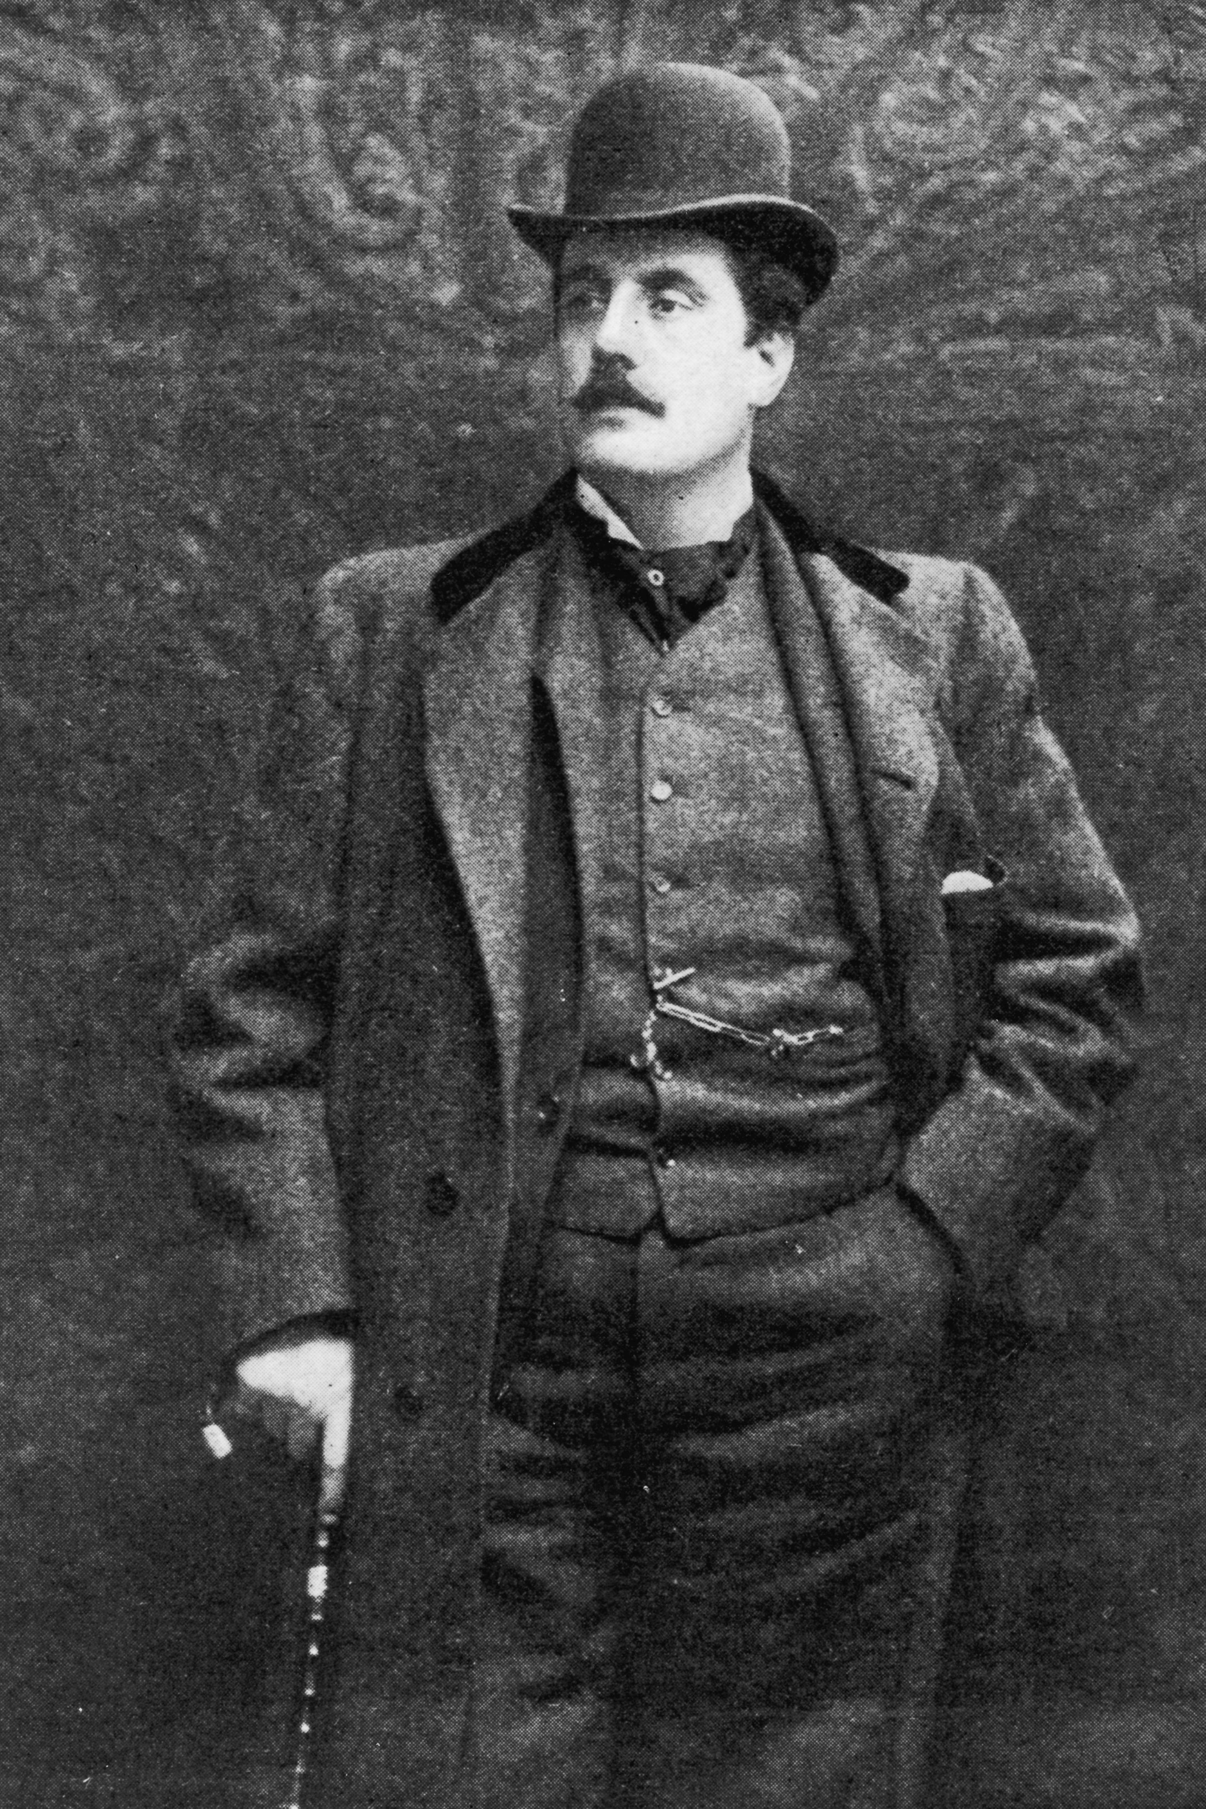
O mio babbino caro
Oh my beloved father,
I like him, he is very handsome.
I want to go to Porta Rossa to buy the ring!
Yes, yes, I want to go there!
And if my love were in vain,
I would go to Ponte Vecchio
and throw myself in the Arno!
I am pining and I am tormented,
Oh God! I would want to die!
Daddy, have mercy, have mercy!
Daddy, have mercy, have mercy!
View a performance here

