Slide 1
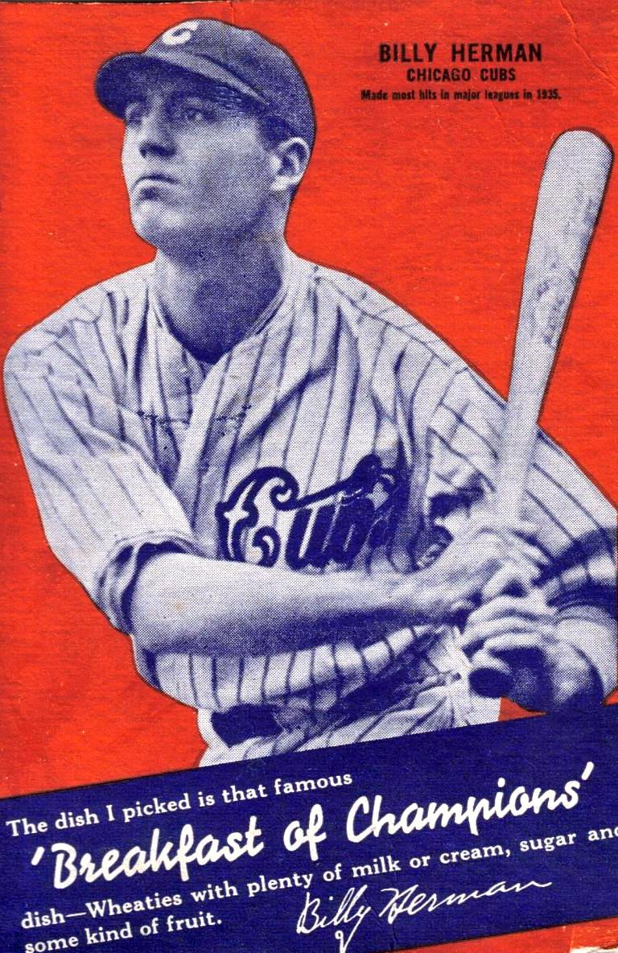
How Jazz Saved Wheaties
● 1922 – Wheaties is created as a result of an accidental spill of a
wheat bran mixture onto a hot stove. The cereal sold in 1924 .
● December 24, 1926, the company aired the first-ever commercial
jingle - sung to the tune of She's a Jazz Baby
● The Wheaties Quartet included a court bailiff, a grain company
executive, an undertaker and a printer.
● They were paid $25 a week – split four ways to sing a 15 minute
program of music that included the Wheaties jingle
● The Wheaties Quartet jingle went national in 1930 and the
product became a sales hit

Slide 2
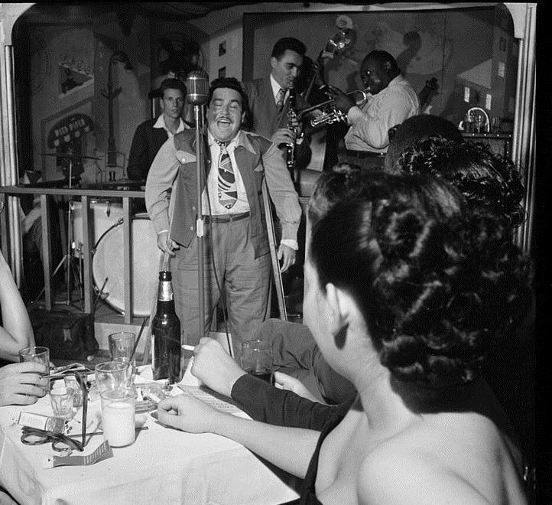
Doc Pompus’ Wedding
● Jerome Solon Felder June 27, 1925 – March 14, 1991
● Rock & Roll Hall of Fame and Blues Hall of Fame as Doc Pompus
● Song credits: A Teenager in Love, Hushabye, This Magic
Moment, Sweets For My Sweet, Little Sister
● Atists include Ray Charles, B.B. King, Irma Thomas, Marianne
Faithfull, Charlie Rich, Dr. John, James Booker
● Childhood polio left him unable to walk without crutches
● Unable to dance at his own wedding he encouraged his wife to
Dance with everyone. On the back of their wedding invitation he
wrote this song for her

Slide 3
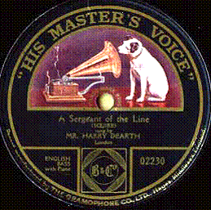
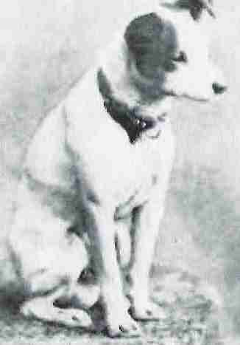
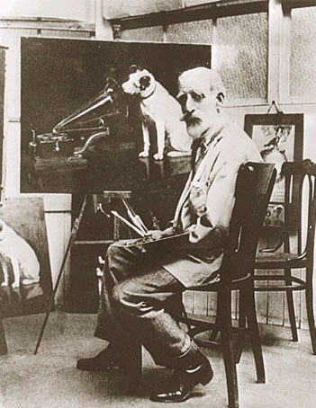
Nipper – His Master’s Voice

Slide 4
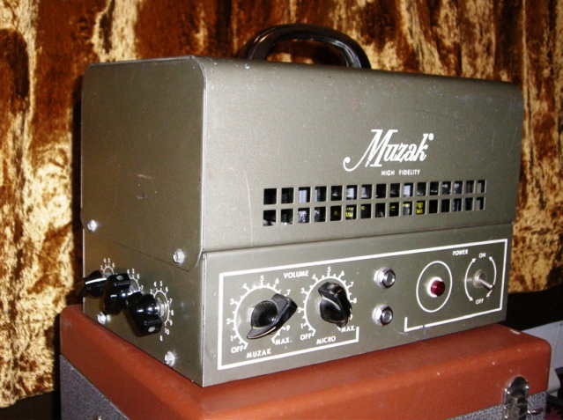
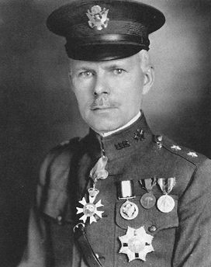
Music Pollution
● George Owen Squier 1865 –1934
West Point 1887 - Ph.D. from Johns Hopkins University 1893
● 1910 invented telephone carrier multiplexing
elected to the National Academy of Science in 1919
● 1922 he created the Wired Radio Company
piped music over phone wires to subscribers for $2/month
● The private subscriber effort failed –
refocused on business clients –
Music makes employees more productive
● 1934 he created a new name for the company
he combined Kodak with music
● That's how Muzak was created

Slide 5
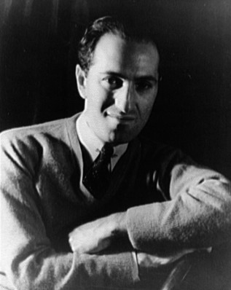
Wail as much as possible !
● November 1, 1923 Paul Whiteman asked George Gershwin to
compose a jazz concerto for an all-jazz concert for February 1924.
● The title Rhapsody in Blue was suggested by Ira Gershwin after
Seeing an exhibition of James McNeill Whistler paintings. Nocturne
in Black and Gold and Arrangement in Grey and Black.
● Gershwin improvised some of what he was playing, and he did not
write out the piano part until after the performance
● The famous opening began as a joke during rehearsal. Gershwin
loved the klezmer-style performance of the clarinet player and told
him to “wail as possible“ during the concert

Slide 6
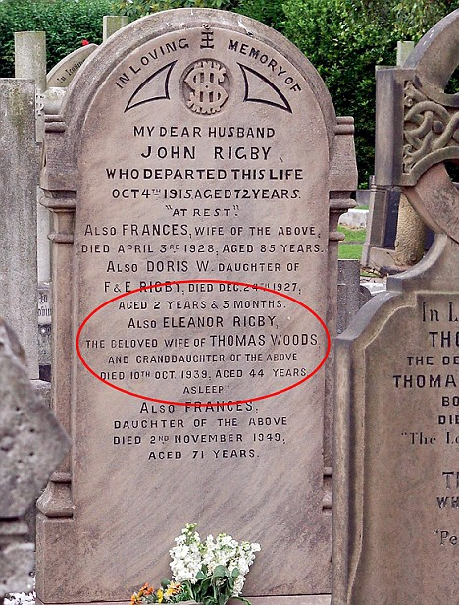
Ian Vaughn and the Graveyard
● July 6, 1957 Ian Vaughn introduced his guitar-playing neighbor to
his bass- playing friend.
● The neighbor’s band was debuting at St. Peter’s Parish Church in Woolton
● That’s how neighbor John Lennon met bass playing Paul McCartney
● The boys used to sunbath in the church cemetery
● That’s where Eleanor Rigby is buried.

