Slide 1
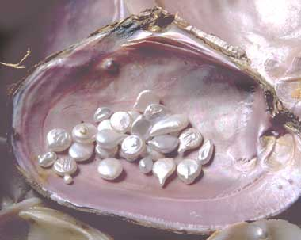
The Common Ground of Music
Tuesday - The Oddly Shaped Pearl

Slide 2
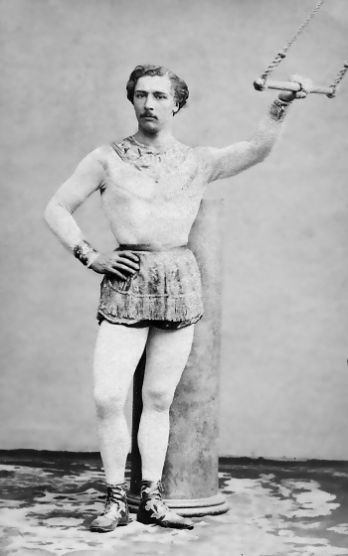
Jules Flying High
● Dad ran a swimming pool and taught gynmastics
● Went to law school, passed the bar exam
● Invented the art of trapezee
● Invented a one-piece knitted garment streamlined for trapeze performance
● Inspired George Leybourne, Gaston Lyle, Alfred Lee to write a song
● His Name was Jules Léotard
Hear a contemporary performance by Bruce Springsteen
LANGUAGE WARNING

Slide 3
Cultural Context of the Baroque
Martin Luther and his 95 Theses ………..
The Argument Begins
The Baroque music is a legacy of the Protestant Reformation
The Peace of Westphalia in 1648
Ended the Thirty Years' War and nearly a century and a half of war, conflict, political intrigue.
The treaty gave the territories almost complete sovereignty.
The Holy Roman Empire became a powerless entity, existing in name only.
The Authority and Power of the Pope dimmed significantly.
The artists, intellectuals, politicians, business people who created the Baroque
were among the first generations to experience the Bible
in their native languages.
The argument over meaning began, still continues and still creates
– Contrasting themes

Slide 4
Baroque Achievements in Music
The violin reaches its penultimate form
The piano is invented ca 1700
Equal Tempered Tuning becomes the standard
Opera is invented and its form defined
Tonality is defined
The “Era of Common Practice”
1600-1900

Slide 5
Provenance of the Violin
Arrives in Europe from China , by way of Persia during the 8th century c.e.
Andrea Amati 1505-1577
Cremona, Italy
established the form of the Violin Family
Listen to the Rebec
Listen to the Erhu
Niccolò Amati 1596 – 1684
grandson of Andrea
Of all the Amati Family violins, those of Nicola
are considered most suitable for modern playing.
Andrea Guarneri 1626 – 1698
apprentice of Nicola Amati
Giuseppe Giovanni Battista Guarneri
1666 - 1739 or 1740,
Andrea's younger son inherited the business in 1698.
He is one of the three great violin makers,
although he struggled to compete with Stradivari.
Antonio Stradivari
1644 – 1737
Apprentice of Nicolò Amati

Slide 6
Violin Facts
 In 2010, a violin built in 1741 by Bartolomeo Guisseppe Guarneri
sold at auction for more than $18 million, the highest
price ever paid for a musical instrument.
 The Baroque violin is VERY different from the modern violin.
Most all Baroque period violins have been modified:
The fingerboard was tilted more, to produce great volume as orchestras got larger
The fingerboard of most old instruments was lengthened one centimeter
so that the violin could be tuned to the rising pitch of the 19th century.
The bass bar was made heavier to allow a greater string tension.
The chinrest was invented in the early 19th century
Antonio Stradivari made 1,000 to 1,100 instruments.
650 of these instruments survive including 450 to 512 violins.

Slide 7
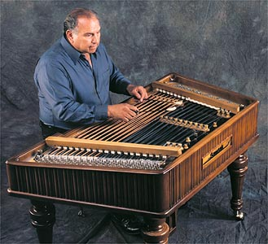
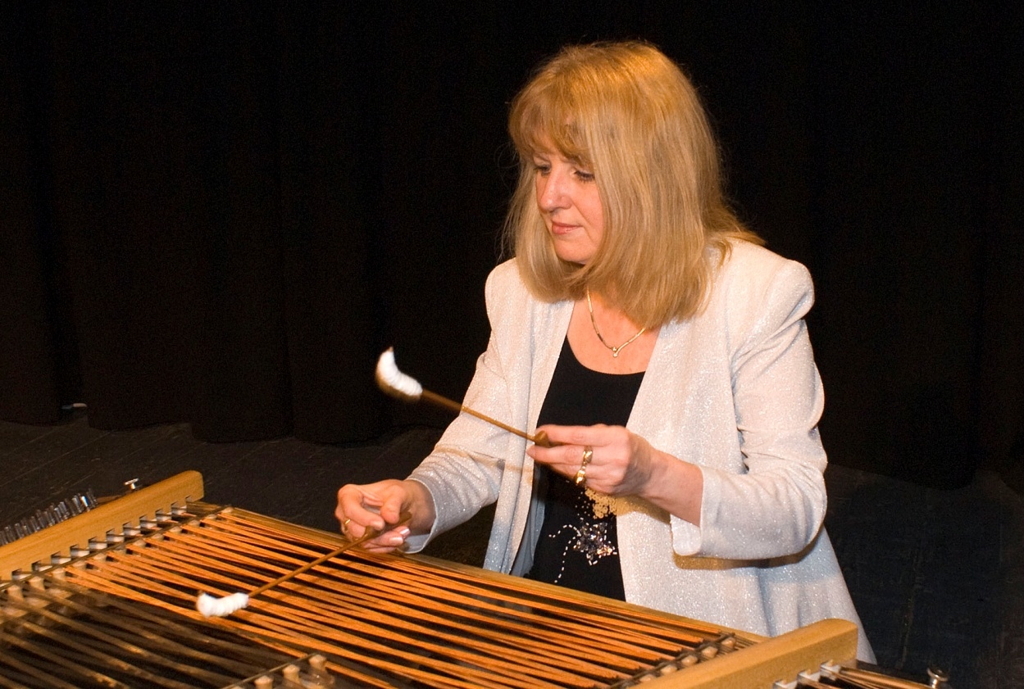
Provenance of the Piano
The Piano is derived from the cimbalom - central European folk instrument
3,500 BCE – an Assyrian bas-relief on a temple in Kyindjuk depicts a struck
chorophone – a dulcimer. Versions the instrument with different names
appear around the Mediterranean and throughout Asia.
Bartolemo Cristofori – an inventor in the Florence workshop of the Medici - set out to “fix” the harpsicord.
View and hear Paganini’s Caprice #24 played on a cimbalom

Slide 8
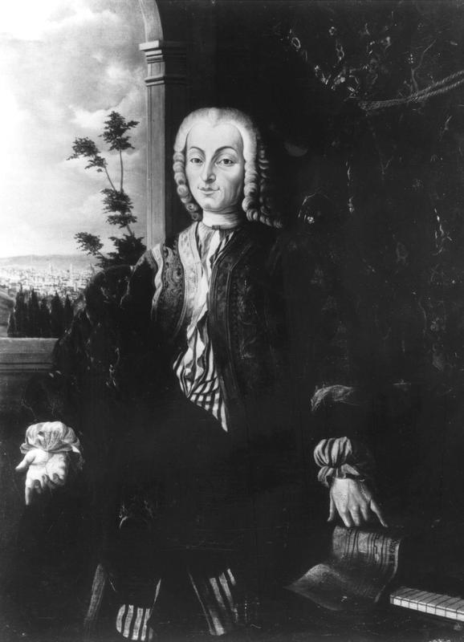
Provenance of the Piano
1700 – the Medici inventory of their property
describes the paino in detail:
“An Arpicembalo by Bartolomeo Cristofori,
of new invention that produces soft and
loud, with two sets of strings at unison
pitch, with soundboard of cypress..."
Arpicembalo", translates to"harp-harpsichord“.
This term was not in general use during
Cristofori's life.
1711 - Three pianos had been built. One
was given to Cardinal Ottoboni in Rome, two
were sold in Florence.

Slide 9
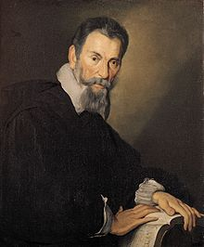
Opera The Beginning of the Baroque
 1598 - Jacopo Peri produces Dafne in Florence Italy.
inspired by Camerata de' Bardi - an elite circle of literate Florentines
 Dafne sought to restore Greek drama. The Greek Chorus sung their parts.
The Camerata were convinced that all roles in a Greek drama had been sung.
 1600 – Peri writes the opera Euridice.
This is the earliest surviving operatic score
 1607 - Claudio Monteverdi writes L’Orfeo
L’Orfeo has remained in the active opera repertoire since its initial performance
L’Orfeo with the musical score (1h 48m)
Notes:
Many Renaissance qualities in the music. You can hear the birth of the Baroque in this music.

Slide 10
Opera Marks the Beginning of the Baroque
 It was a new musical form with an undisputed birthdate - 1598
 Traditional opera consists of two modes of singing:
Recitative, the plot-driving passages sung in a style that emphasizes the inflections of speech
Aria (an "air" or formal song) in which the characters express their emotions in a melodic style.
 The audience suffers through the necessary recitatives in great anticipation of the beautiful arias that follow!
Emotions…… how people FEEL about events became important.
Notes:
The Italian word was first used in the sense "composition in which poetry, dance, and music are combined" in 1639;
The first recorded English usage in this sense dates to 1648

Slide 11
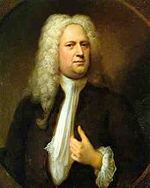
Opera as a Blood Sport
 1704 during a performance of Johann Mattheson’s 3rd opera Cleopatra.
 Mattheson challenged Handel to a duel over
which of them was to play the harpsichord during
the performance
Mattheson's blade was deflected and broken by a large button on Handel's jacket.

Slide 12
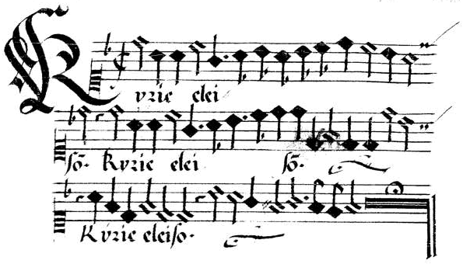
Counterpoint
 Counterpoint is the relationship between voices
interdependent harmonically
independent in rhythm and shape
The term originates from the Latin punctus contra punctum :"point against point".

Slide 13
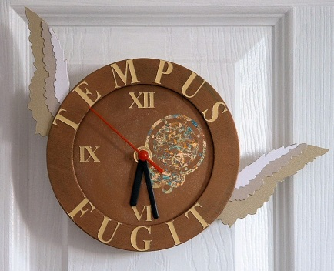
What is a Fugue?
Tempus Fugit
Time Flies
Fugit from the Latin fugere
Meaning to flee
A fugue is a music composition in which
the main idea is chased by other ideas.
The main idea FLEES and is never caught
First Known Use:
1597
Notes:
A fugitive does not ‘fly” a fugitive FLEES because he is chased

Slide 14
The Fugue
 One or two or more themes are repeated by successively entering voices
and developed using technique of counterpoint, modulation and variation
 In its simplest configuration a fugue may be the expression of a single
musical idea followed by the development of that idea.
 A fugue is a continual flow of subject and answer
 The fugue as a process rather than form
A fugue
 Is a metaphor (one thing standing in place of another)
 reveals the connections between seemingly unlike things.
 develops an idea in ways that are never precisely the same – a fugue “tweaks” ideas
 demonstrates relationships between new ideas and old ideas
contrasts ideas through the use of conflict – that is “counterpoint”

Slide 15
The essence of a fugue
its ability to permit the discovery that
new ideas are created out of the
same "stuff" as old ideas.

Slide 16
Elements often found in a fugue
When listening to a fugue, try to hear these elements:
Subject (always the 1st melody)
Answer (usually the 2nd melody)
Counter subject (sometimes the 2nd melody)
Development of the subject
Coda (the final segment of the composition)

Slide 17
Defining Elements of the Fugue
Subject
Melody that comprises the primary melodic and rhythmic content of the fugue.
Answer
An imitation of the subject that follows immediately after the
first statement of the subject. The answer is played by a
different instrument and usually at a higher pitch.
Countersubject
Counterpoint to subjects or answers played simultaneously by a different instrument. Not every fugue will have a countersubject.

Slide 18
The Twinkle Fugue
● Subject
● Answer Tonal
● Subject Modulated
The Twinkle Fugue
● Real Answer
● Counterpoint
● Counter Subject
● Continuo
● Coda Continuo
● Coda Cello

Slide 19
A Sample Fugal Structure

Slide 20
Fugues by the Masters
J. S. Bach
Fugue in G minor
“The Little Fugue”
George Gershwin
Catfish Row
Suite from Porgy & Bess
1936

Slide 21
Concerto Grosso Structure
 A Concerto Grosso contrasts a small group of instruments against
a large group of instruments.
 The small group is called concertino.
 The large group is call tutti or ripieno, or concerto grosso.
 Sometimes both play together, sometimes one plays by itself, or the two
groups might imitate one another.
“Concerto grosso” is Italian for “big concerto”.
Corelli's concertino group: 2 violins and a cello,
Corelli's ripieno group: A string section was added to form the ripieno group.
Both groups were accompanied by a basso continuo formed by some
combination of harpsichord, organ, lute or theorbo.
Handel wrote several collections of concerti grosso, and several of Bach’s
Brandenburg Concertos by Bach also loosely follow the concerto grosso form.

Slide 22
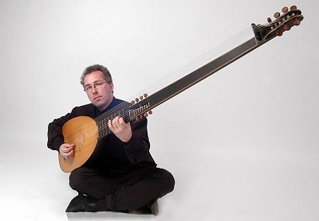
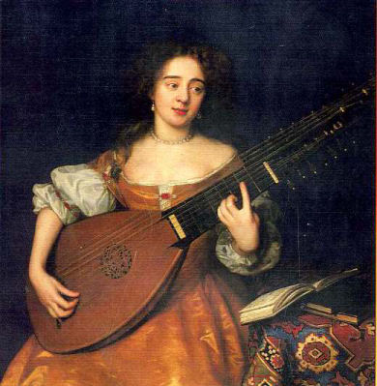
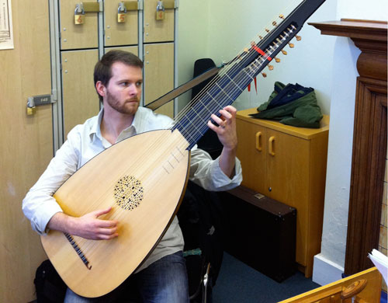
Corelli’s Concertino & Ripieno
 Corelli's concertino group was invariably:
2 violins and 1 cello
 Corelli's ripieno or tutti group was:
continuo. The basso continuo was
some combination of harpsichord,
organ, lute or theorbo.

Slide 23
Listening Guide Corelli Op. 6 No. 2 F Major
1st Movement 4:24
Vivace 0:0 - 0:19 concertino -tutti
Allegro 0:19 - 1:01 tutti sudden stop
Adagio 1:01 -2:06 concertino
Allegro 2:07 - 2:22 concertino - tutti
Vivace 2:23 - 3:23 tutti
Largo Andante 3:23 -4:24 concertino
Vivace – lively and fast Lively Mood Vivid (132–140 BPM)
Allegro – fast, quickly, and bright (120–160 BPM)
Andante – at a walking pace (84–90 BPM)
Adagio – slow and stately (literally, "at ease") (55–65 BPM)
Largo – broadly (45–50 BPM)
Grave – slow and solemn (20–40 BPM)
Listen to the music here

Slide 24
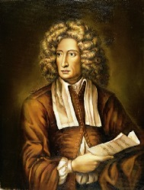
Listening Guide Corelli Op. 6 No. 2 F Major
2nd Movement 1:43
Allegro
3rd Movement 1:42
Grave 0:0 - 0:28
Andante Largo 0:28 - 1:42
4th Movement 2:10
Allegro concertino -ripieno

Slide 25
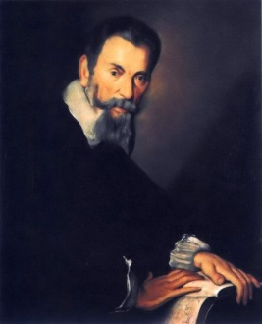
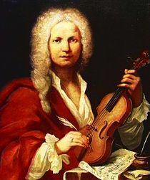
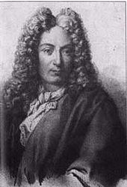
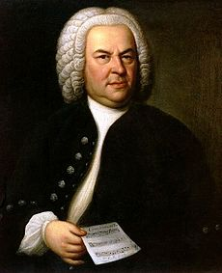
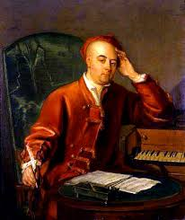
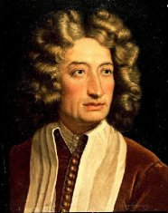
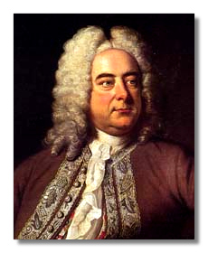
The Baroque
New Instruments
New Forms
New Tuning
Opera is invented and its form defined
Orchestra is defined
The “Era of Common Practice” in music begins
1600-1900

